Slide 1






G20-MAIT INTRA-COLLEGE HACKATHON 30-31, MARCH 2023
Problem Statement Title: Spam Alert System (Software Edition)
Team Name: Code Crafters
Team Leader Name: Jinal Gupta
Mentor Name: Dr. Anshu Khurana

Slide 2
Mail received
User Action
Viewing an email within a given time span
Admins Action according to Users Action
Idea/Approach Details
Spam Warning System with Detection and Prevention Capabilities :
PROBLEM:
Difficulty in identifying irrelevant mails.
PROPOSED SOLUTION:
Duration based filtering
Text based filtering
Feedback based filtering
Data Processing: Apache Spark
Data Storage: MongoDB
Messaging System: RabbitMQ
Web framework: Flask, Django
Programming Language: Python
Cloud platforms: Amazon Web Services(AWS)
Machine Learning: Scikit - learn
Visualization and dashboarding: Tableau, PowerBI
DevOps and Automation: Kubernetes

Slide 3
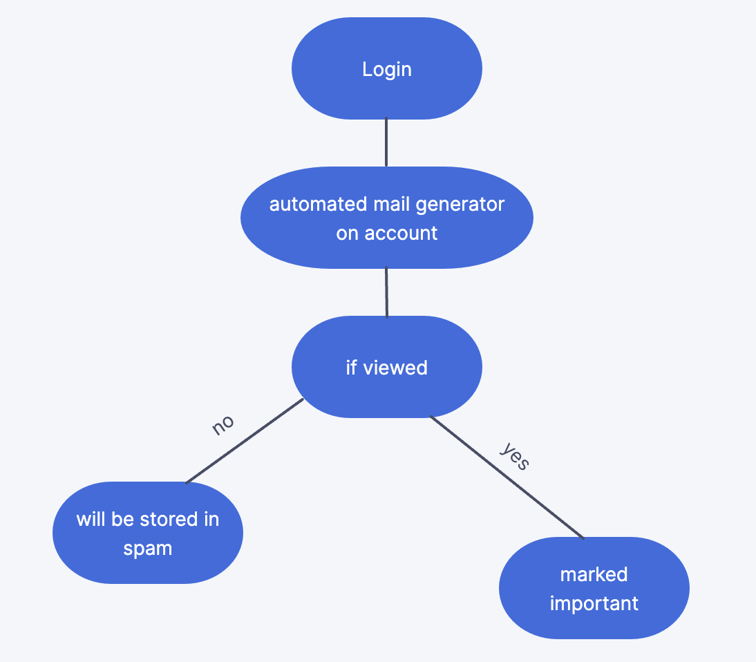

Idea/Approach Details
Our Dependencies / Show stoppers
Our Use Cases :
1.If we don’t log in to our mail for a month then automatically all the mails will go into the spam folder.
2. If we unintentionally open a random mail that is not important mail so it will not go into the spam folder.
3. If we read a mail through the mobile notifications and forget to mark it as important then it will go to the spam folder automatically after the given timespan.
Admin
Mail Accessed
User

Slide 4
Team Member Details
Sr. No. | Name of Team Member | Course (B.Tech/MBA etc): | Stream (ECE, CSE etc): | Year | Position in team
1 | Jinal Gupta | B.Tech | AI&DS | 2nd | Team Leader
2 | Aryan Giri | B.Tech | AI&ML | 2nd | Team Member
3 | Bhavika Narang | B.Tech | AI&DS | 2nd | Team Member
4 | Sanidhya Bansal | B.Tech | AI&DS | 2nd | Team Member
5 | Soumyadeep Deb | B.Tech | ECE | 2nd | Team Member
Team Mentor Details
Sr. No. | Name of Mentor | Department
1 | Dr. Anshu Khurana | AI&DS

